Slide 1

Predicting High-Selling Products Using Machine Learning on Retail and Warehouse Sales Data
Kisan Nallusamy Dhanabackiam (KN316)
Risvan Alangadan (RA725)

Slide 2
Motivation & Background
Retail firms manage huge volumes of sales and warehouse data on a monthly basis.
Early identification of top-selling products can enhance inventory, cut down on waste, and maximise profits.
Machine learning offers strong abilities to discern sales trends and predict with accuracy.
This project investigates how data-based retail decisions can be assisted by classification and clustering models.

Slide 3
Research Questions
Can you predict if a product will be a bestseller using warehouse sales and retail sales?
What sales behaviour trends can be revealed with unsupervised learning?
How are machine learning models able to assist retail inventory and marketing decisions?

Slide 4
Data Overview
Dataset source: Kaggle – Warehouse and Retail Sales Data
Total records: 300,000 rows
Key variables:
RETAIL.SALES, RETAIL.TRANSFERS, WAREHOUSE.SALES
ITEM.TYPE, ITEM.CODE, MONTH, YEAR
Created a binary target: High_Seller (1 = above median retail sales)
Handled missing values by treating them as zero (assumed no activity)

Slide 5
Methodology
Data Preparation:
Replaced missing sales values with 0
Created High_Seller target (1 = sales above median)
Applied one-hot encoding to ITEM.TYPE
Classification Model:
Used Logistic Regression to predict high-selling products
Evaluated with 10-fold cross-validation
Accuracy: 83.7%, ROC: 0.91

Slide 6
Unsupervised Learning:
Applied K-Means Clustering on average warehouse and transfer data
Determined 3 optimal clusters using the Elbow Method

Slide 7
Model Comparison – Classical Alternatives
Chosen model: Logistic Regression – suited for binary classification
Why this model?
Interpretable and easy to explain to non-technical users
Performs well with categorical features (e.g., item type)
Strong performance: Accuracy 83.7%, ROC 0.91
Alternatives considered:
Decision Tree, K-Nearest Neighbours (KNN)
Not used due to higher overfitting risk and lower generalisation
Logistic regression provided stable, consistent results across all folds.

Slide 8
Unsupervised Learning: K-Means Clustering
Applied K-Means clustering on average warehouse sales and retail transfers
Data standardised before clustering
Elbow Method suggested 3 optimal clusters
Identified meaningful product groups:
Cluster 1: Low sales in both warehouse and retail
Cluster 2: High warehouse, low retail (possible overstock)
Cluster 3: High sales in both (consistent top-sellers)

Slide 9
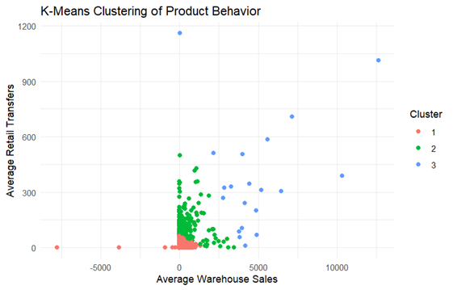
Figure: Three different groups were identified by K-means clustering based on product sales behaviour. Cluster 3 shows best sellers, Cluster 2 can identify products which are in excess stock, and Cluster 1 contains low-selling items.

Slide 10
Recommendations
Inventory optimised by product performance clusters
Sell off or upgrade excess products (Cluster 2)
Stock more bestsellers (Cluster 3) and sell them in particular
Verify low performers (Cluster 1) for bundling or discontinuance opportunities
Use model forecasts to guide future ordering and pricing decisions
More specific descriptions in future analysis (price, area, promotion) in order to more thoroughly learn

Slide 11
Limitations
Few variables: There were just variables for sales-related variables — no price, location, or promotion variables.
Missing data assumption: Replaced missing sales with zeros, which is not necessarily representative of actual sales patterns
Model constraint: Logistic regression is based on linear relationships and may miss sophisticated patterns Simplification by clustering: K-means spherical clusters and equal size assumptions may not be true product groups.

Slide 12
Conclusion
Used applied logistic regression to classify best-selling products with 83.7% accuracy and fine ROC performance.
Utilised K-means clustering to find out product categories: low achievers, overstock risk, and best sellers.
Insights inform data-driven decisions in inventory management and marketing strategy.
Machine learning can assist stores with quicker reaction to demand patterns and more effective operations.
Future studies may incorporate additional features and models to enhance the accuracy.

Slide 13
Thank you

